Slide 1
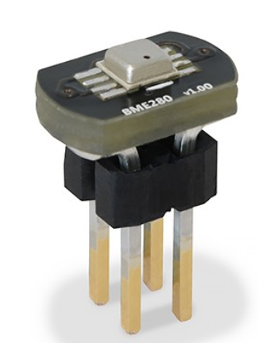
Sensors | Code | Specification
Temperature sensor BME280 | #include <WaspSensorAgr_v30.h> float temp; void setup() { USB.ON(); USB.println(F("Start program")); Agriculture.ON(); } void loop() { temp = USB.print(F("Temperature: ")); USB.print(temp); USB.println(F(" Celsius")); delay(1000); } | • Operational range: -40 ~ +85 ºC • Full accuracy range: 0 ~ +65 ºC • Accuracy: ±1 ºC (range 0 ºC ~ +65 ºC) • Response time: 1.65s (63% response from +30 to +125 °C). • Typical consumption: 1 μA measuring
Humidity sensor BME280 | #include <WaspSensorAgr_v30.h> float temp; void setup() { USB.ON(); USB.println(F("Start program")); Agriculture.ON(); } void loop() { humd = Agriculture.getHumidity(); USB.print(F("Humidity: ")); USB.print(humd); USB.println(F(" %")); delay(1000); } | • Measurement range: 0 ~ 100% of Relative Humidity • Accuracy: < ±3% RH (at 25 ºC, range 20 ~ 80%) • Hysteresis: ±1% RH • Operating temperature: -40 ~ +85 ºC • Response time (63% of step 90% to 0% or 0% to 90%): 1 sec • Typical consumption: 1.8 μA measuring • Maximum consumption: 2.8 μA measuring
Pressure sensor BME280 | #include <WaspSensorAgr_v30.h> float temp; void setup() { USB.ON(); USB.println(F("Start program")); Agriculture.ON(); } void loop() { pres = Agriculture.getPressure(); USB.print(F("Pressure: ")); USB.print(pres); USB.println(F(" Pa")); delay(1000); } | • Measurement range: 30 ~ 110 kPa • Operational temperature range: -40 ~ +85 ºC • Full accuracy temperature range: 0 ~ +65 ºC • Absolute accuracy: ±0.1 kPa (0 ~ 65 ºC) • Typical consumption: 2.8 μA measuring • Maximum consumption: 4.2 μA measuring

Slide 2
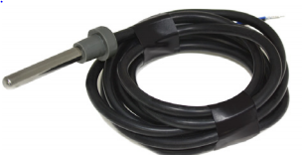
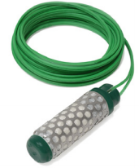
Sensors | Code | Specification
Soil temperature sensor Pt-1000 | #include <WaspSensorAgr_v30.h> float value; pt1000Class pt1000Sensor; void setup() { USB.ON(); USB.println(F ("Start program")); Agriculture.ON(); } void loop { value = pt1000Sensor.readPT1000(); USB.print(F("PT1000: ")); USB.printFloat(value,3); USB.println(F(" ºC")); delay(2000); } | Measurement range: -50 ~ 300 ºC Accuracy: DIN EN 60751 Resistance (0 ºC): 1000 Ω Diameter: 6 mm Length: 40 mm Cable: 2 m
Soil moisture sensor Watermark | #include <WaspSensorAgr_v30.h> float watermark1; watermarkClass wmSensor1(SOCKET_1); void setup() { USB.ON(); USB.println(F("Start program")); Agriculture.ON(); } void loop() { USB.println(F("Wait for Watermark 1...")); watermark1 = wmSensor1.readWatermark(); USB.print(F("Watermark 1 - Frequency: ")); USB.print(watermark1); USB.println(F(" Hz")); USB.println(); delay(1000); } | Measurement range: 0 ~ 200 cb Frequency Range: 50 ~ 10000 Hz Diameter: 22 mm Length: 76 mm Terminals: AWG 20

Slide 3
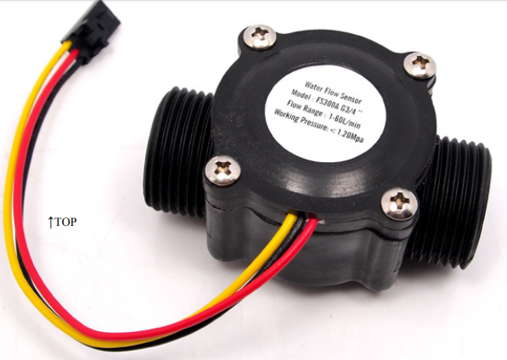
Sensor | Code | Specification
Water flow Sensor FS300A | #include <WaspSensorEvent_v30.h> bool flag = false; flowClass fs300a(SENS_FLOW_FS300); void setup() { USB.ON(); USB.println(F("Start program")); Events.ON(); Events.attachInt(); } void loop() { value = fs300a.flowReading(); USB.print(F("Flow: ")); USB.print(value); USB.println(F(" l/min")); USB.print(F("Change flow interruption flag each loop(): ")); if (flag == true) { fs300a.disableFlowInt(); USB.println(F("DISABLED")); flag = false; } else { fs300a.enableFlowInt(); USB.println(F("ENABLED")); flag = true; } } | Mini. Wokring Voltage DC 4.5V Max. Working Current 15mA(DC 5V) Working Voltage 5V～24V Flow Rate Range 1～60L/min Load Capacity ≤10mA(DC 5V) Operating Temperature ≤80℃ Liquid Temperature ≤120℃ Operating Humidity 35%～90%RH Water Pressure ≤2.0MPa

Slide 4
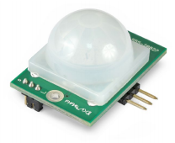
Sensor | Code | Specification
Presence sensor PIR | #include <WaspSensorEvent_v30.h> uint8_t value = 0; pirSensorClass pir(SOCKET_1); void setup() { USB.ON(); USB.println(F("Start program")); Events.ON(); value = pir.readPirSensor(); while (value == 1) { USB.println(F("...wait for PIR stabilization")); delay(1000); value = pir.readPirSensor(); } Events.attachInt(); } void loop() { value = pir.readPirSensor(); if (value == 1) { USB.println(F("Sensor output: Presence detected")); } else { USB.println(F("Sensor output: Presence not detected")); } } | Height: 25.4mm Width: 24.3mm Length: 28.0mm Consumption: 100μA Range of detection: 6 ~ 7m Spectral range: ~ 10μm

